Slide 1
Logo animation (intro)

Slide 2

Title slide
Running language models locally AI Gilde 11-07-2024
Maarten Smeets

Slide 3




Benefits of running a model locally
Privacy Running locally keeps questions and answers local. No data goes to Microsoft, Google, OpenAI, …
Cost There are no provider costs per API request (although initial hardware investment)
Finetune your LLM to your needs Train it on your own data, make it specialized for your usecase Consider timeseries prediction, file identification, OCR
Censoring optional Uncensored models have vastly improved intelligence, creativity, and responsiveness https://erichartford.com/uncensored-models

Slide 4

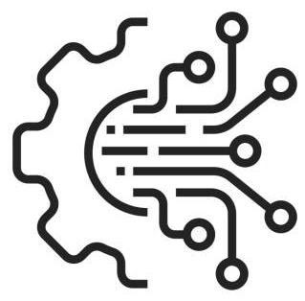

Challenges when running a model locally
Often not as good Open source models are generally not as good as proprietary models N.b. this is not the case for embedding models
More complex to run and integrate Running and integrating local models is often more complex Consider internet lookups and RAG implementations
Hardware requirements To be able to run open source models locally requires hardware At least 64Gb of CPU RAM is recommended If you want to run (partially) on GPU, Nvidia RTX4080 or better recommended

Slide 5
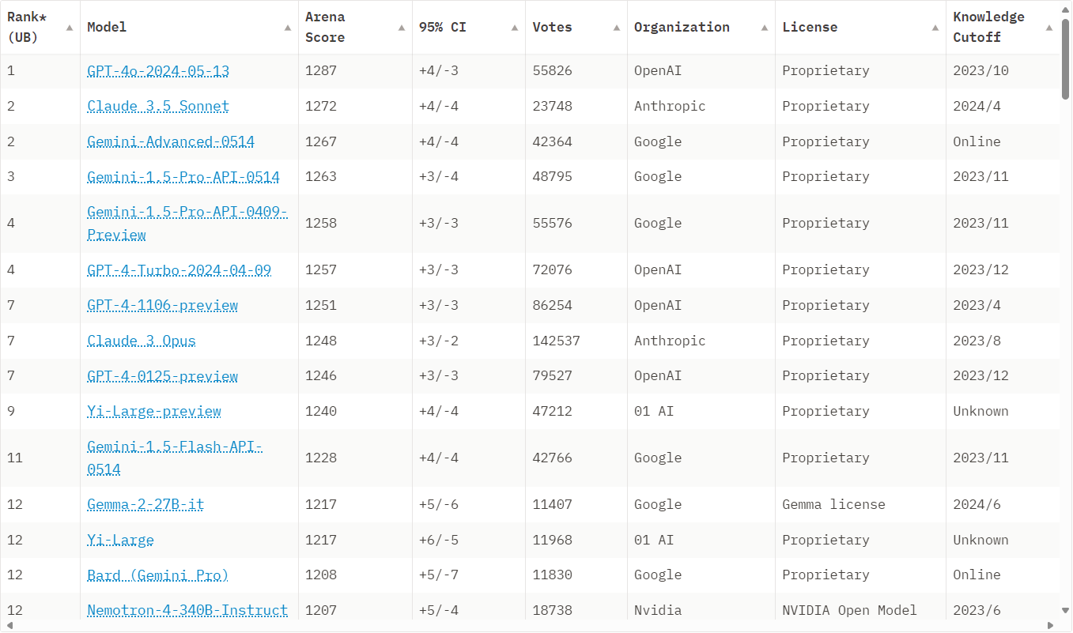
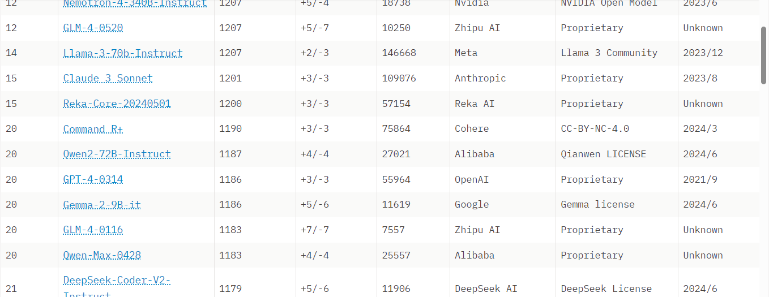
Which LLM models can you run locally?
LLMs: Chatbot Arena LMSYS Leaderboard 08-07-2024
Providers of open source models include
Meta
Google
Alibaba
Mistral

Slide 6
Usecase examples
Critical systems If you do not want to depend on an internet connection or are not allowed to use one, you can run models locally
Research/development Learning about LLM technology, finetuning
Models on small devices OCR, translation, personal assistants, realtime timeseries analyses, anomaly detection
Agent frameworks Agent frameworks enable LLMs to perform autonomous tasks. This often requires a lot of calls to an LLM which can become expensive. Using a local model reduces cost

Slide 7
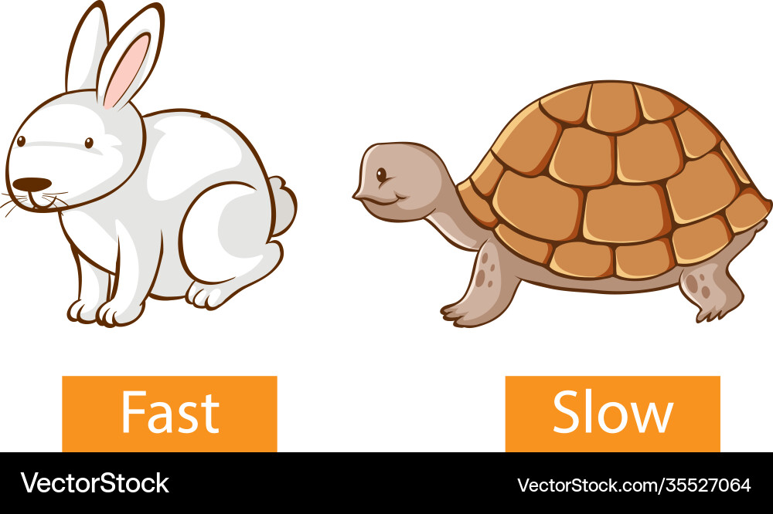
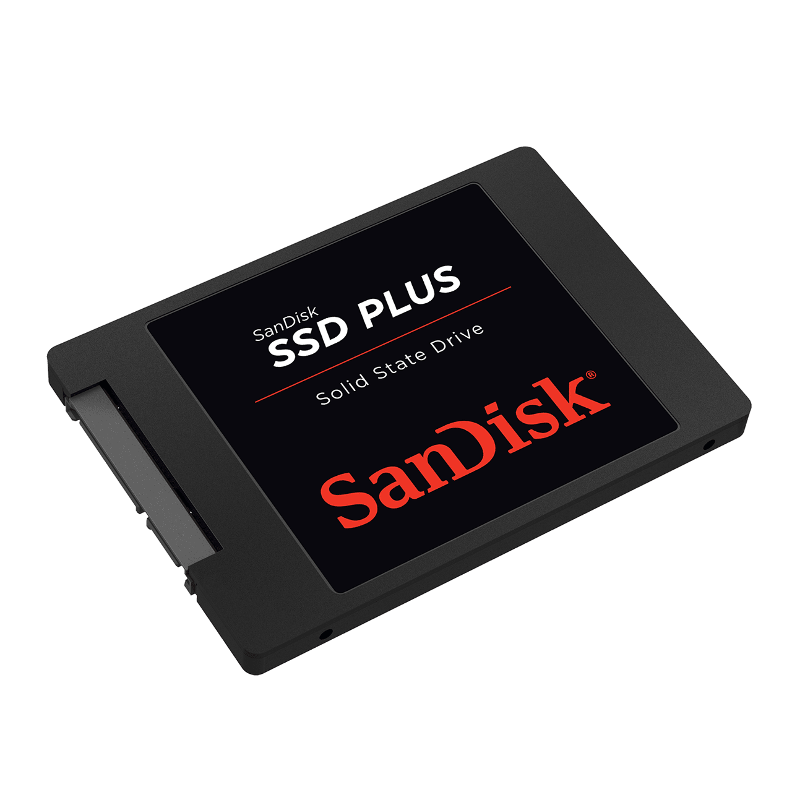
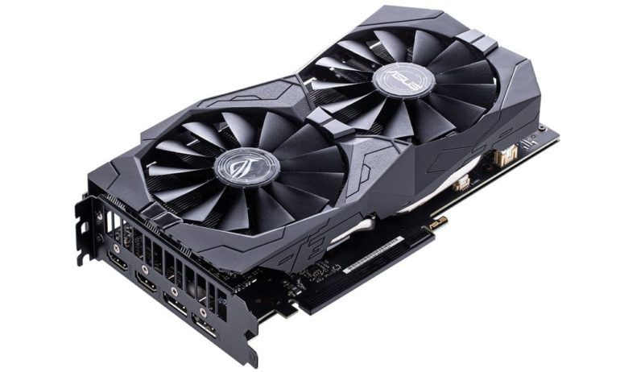
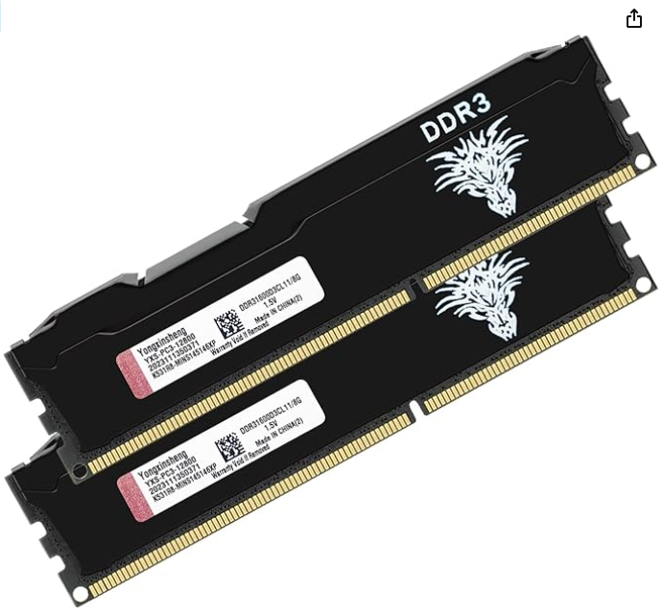
Hardware requirements RAM!
GPU RAM. Nvidia recommended
CPU RAM
Solid State Drive swapfile

Slide 8
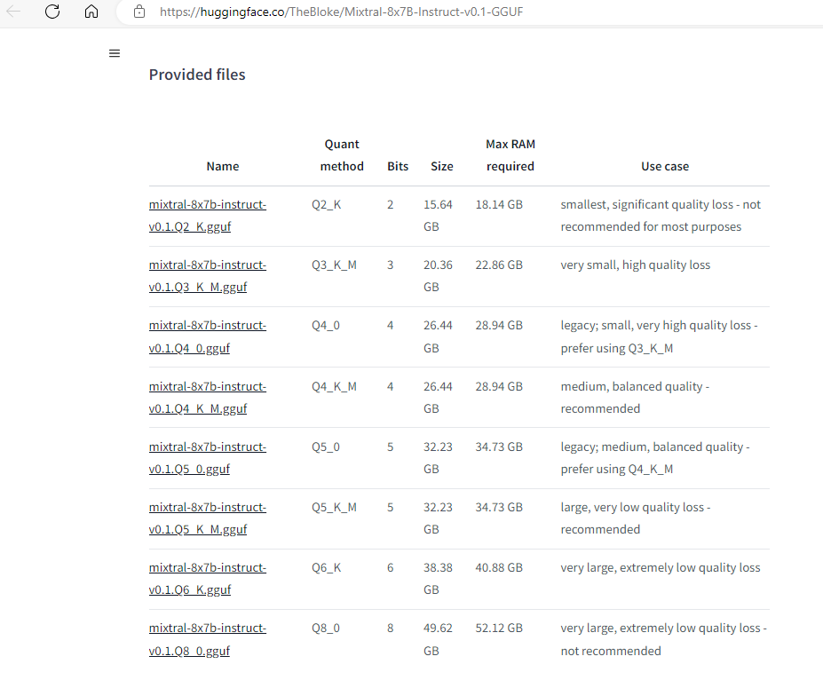
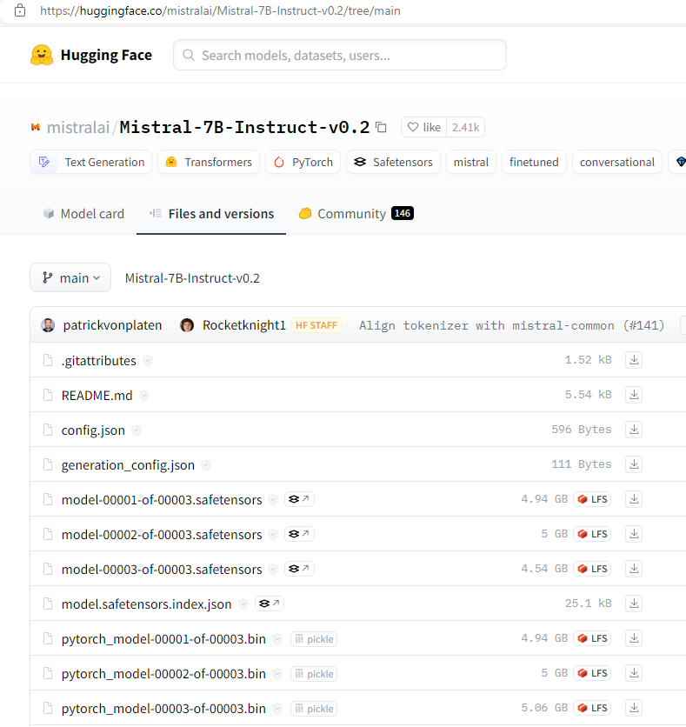
Hardware requirements
In general you need a couple of GBs more RAM than the model size
Mixture of Expert models require less RAM per parameter compared to non-MoE models
Transformers requires more 32Gb RAM for this one
https://www.reddit.com/r/LLMDevs/comments/1crnjof/mistral_gpu_memory_requirements/

Slide 9
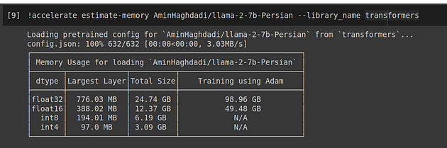
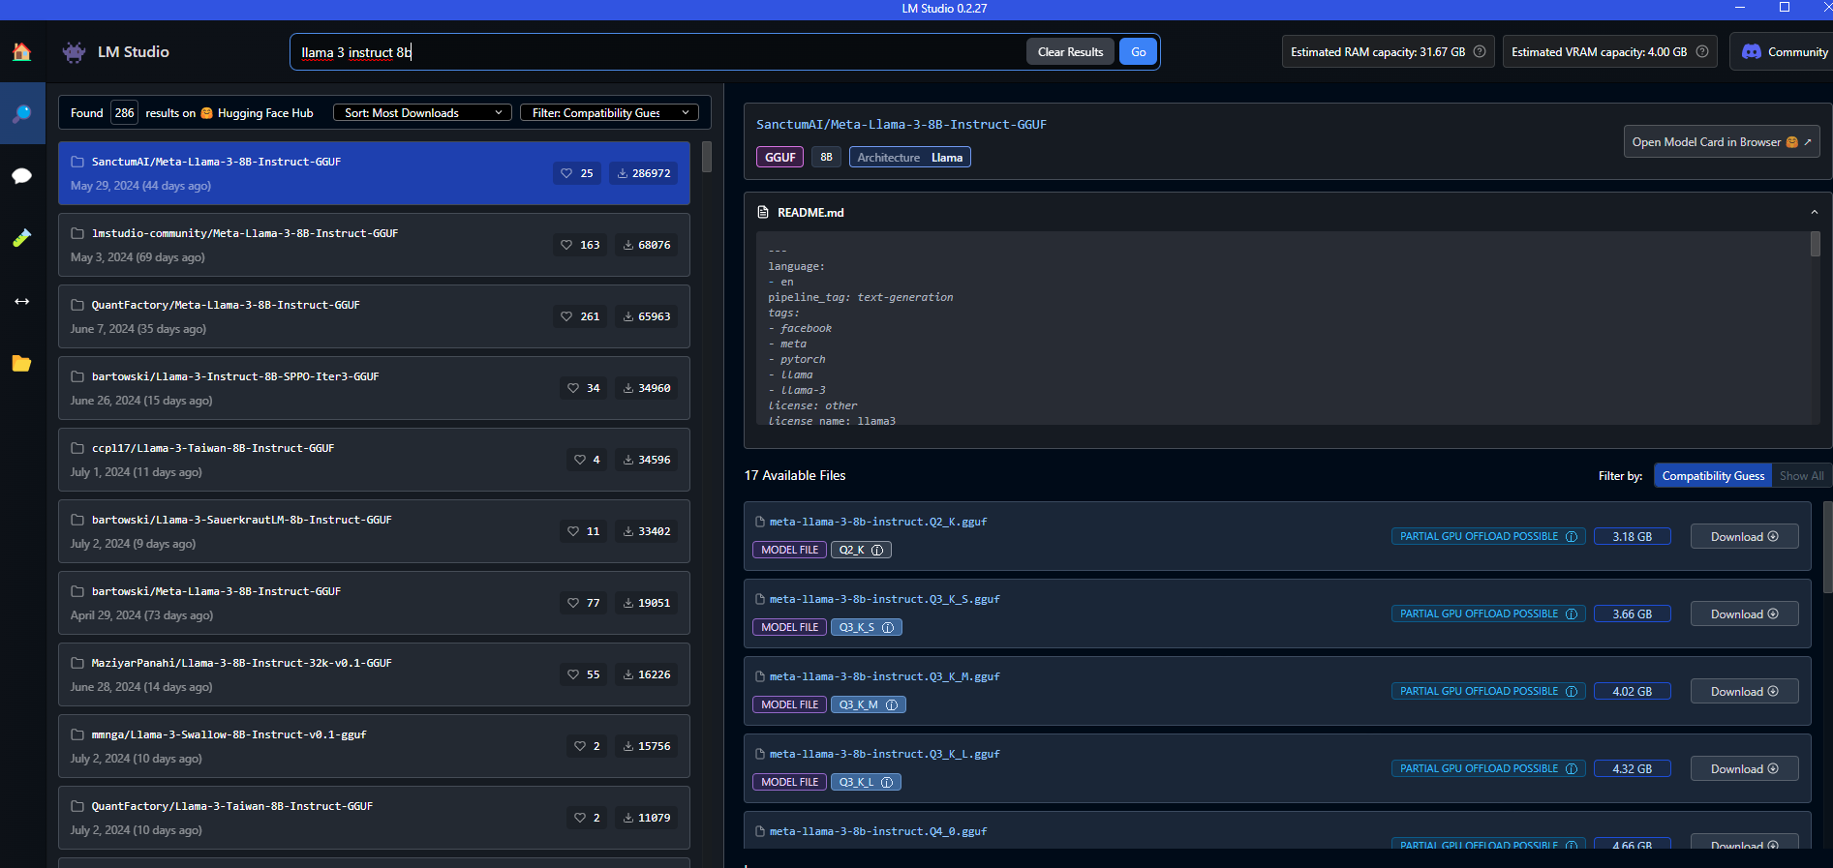
Hardware requirements
Estimate memory using accelerate pip install accelerate huggingface_hub transformers
Estimate memory using LM Studio
accuracy

Slide 10
How to select a model?
Parameters More parameters is better but requires better hardware to run More parameters quantized is often better than less parameters
Leaderboards You can browse models and leaderboards on Huggingface. A better score on a leaderboard usually means a better model.
Supplier Be selective in model supplier. There are a lot of peculiar and dangerous models to be found
Quantization Quantization reduces model accuracy slightly but hardware requirements a lot. Quantized models are usually recognizable as GGUF files
Model type Different types of models for different purposes.
Foundation: best for finetuning
Instruct: follows instructions
Chat: for conversations
Completion: for completing texts, code completion
Other: Summarization, Translation, Sentiment analyses

Slide 11
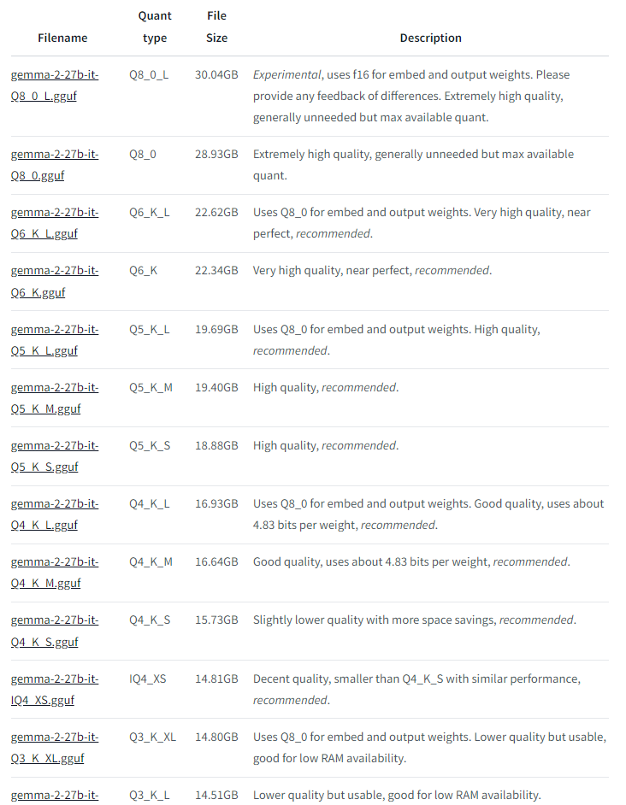
How to select a model example
Why this model:
Original model is best non proprietary model in Chatbot Arena
Google is the supplier of the original model
It is an instruct model, not foundation or chat.
Gemma unquantized requires around 80Gb of RAM but gemma-2-27b-it-Q6_K-L.gguf can run on 32Gb RAM and is near perfect
Running a GGUF can split execution over CPU and GPU RAM
Bartowski quantized the model. He is a big name in the LLM community. His identity or the company he works for is not public. Would not run it in production at a customer
https://huggingface.co/bartowski/gemma-2-27b-it-GGUF

Slide 12
Tools to run a model locally
Hosting an API LLMs with an OpenAI compliant API
CLI
Ollama (MIT license)
GUI
LM Studio (proprietary)
Library
llama-cpp-python (MIT)
Running Libraries
llama-cpp (MIT licence)
Facebooks PyTorch (Caffe2 license). Runs mostly pt, pth, onnx files. GPU optimized (especially NVIDIA CUDA).
Huggingface Transformers (Apache 2.0 license)
GUI (no API)
AnythingLLM
Integrating Frameworks for integrating LLMs using code
LlamaIndex: structuring external data for use with LLMs
LangChain: simplify the integration with LLMs

Slide 13
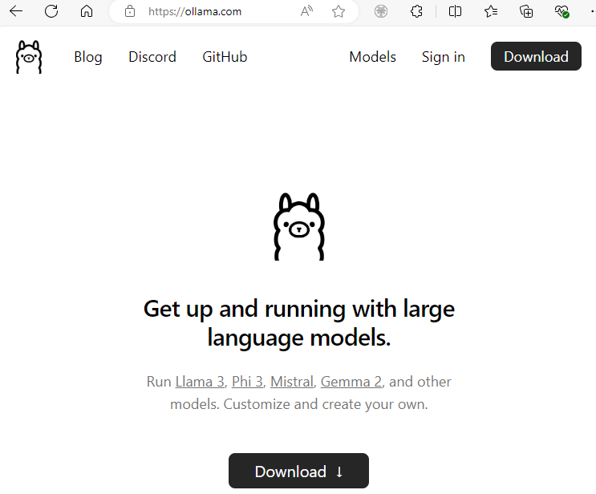
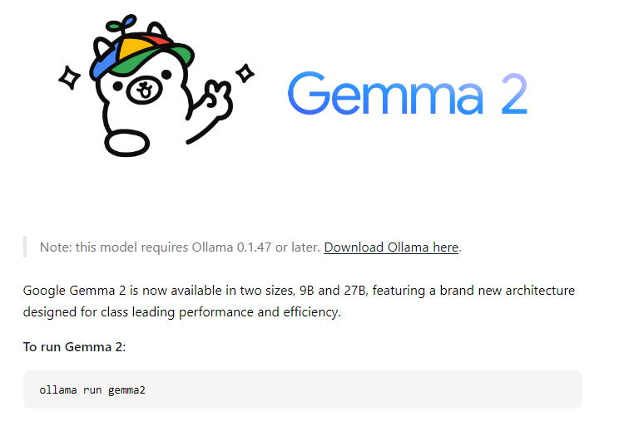
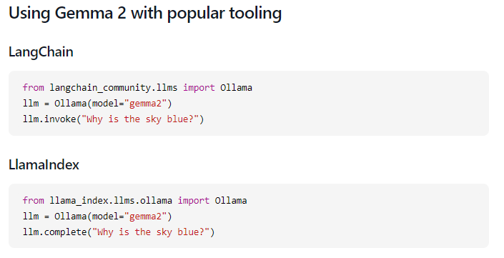
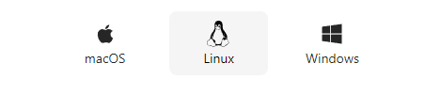
ollama

Slide 14
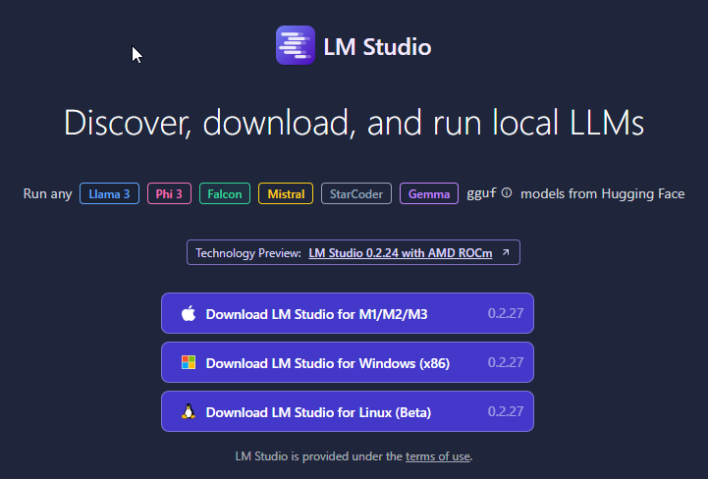
LMStudio

Slide 15
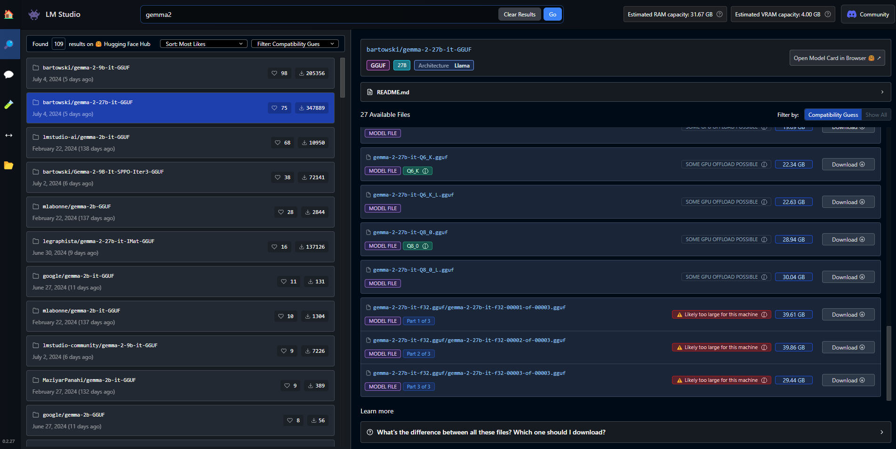
LM studio Model selection
Available resources
Huggingface likes and downloads
Requirements estimate. Can you run it?

Slide 16
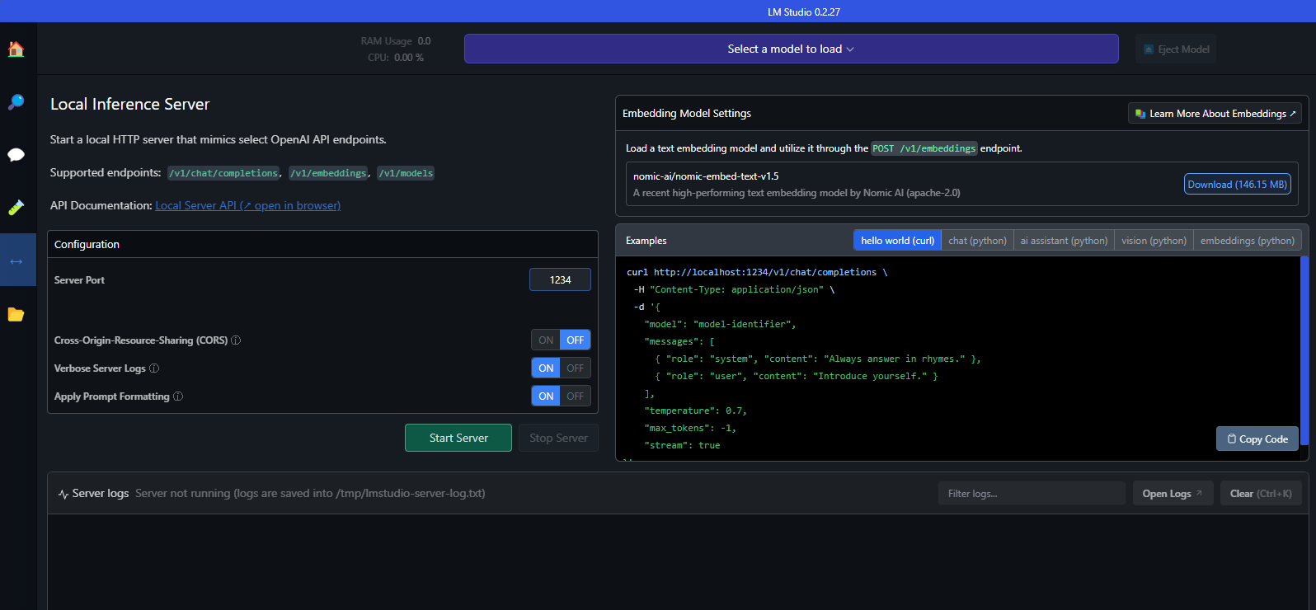
LM studio running a local server

Slide 17
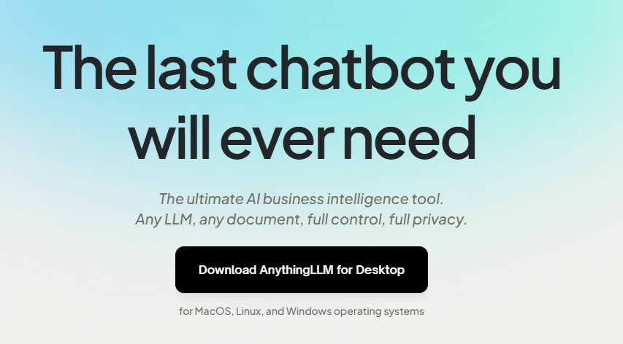
Anything LLM
Full-Stack Application
Support local and remote hosted LLMs
Supports commercial and open-source LLMs, various vector databases, and embedding models
Document Management
Handles multiple document types (PDFs, DOCX, TXT, etc.)
Uses workspace model for containerized document context management
AI Agents
Perform tasks like web browsing, web scraping, and running code
Tools include RAG search, chart generation, and document summarization
Multi-User Support
Multi-user management with permissions
Developer API for custom integrations
Extensive Model Support
Compatible with GPT-4, Llama, OpenAI, Azure, Hugging Face, etc.
Supports various embedding and transcription models
N.b. this application does not provide API hosting functionality

Slide 18
Personal Preferred setup
Ollama for hosting the LLM on an API
Using an OpenAI compliant API makes it easy to use from multiple applications and code
It is stable and easy to use. Bad experiences with LM Studio API.
They have their own library with a limited set of models. Using other models is possible but more work
HuggingFaceEmbedding for running embedding models from within Python code
It will download the model when not in the local cache
Faster when using a lot of documents than access by API
Challenges with using ollama for embeddings. No OpenAI compliant API.
LlamaIndex for integration
Requires less code than LangChain for similar functionality
Feels more intuitive than LangChain. Easier to use

Slide 19
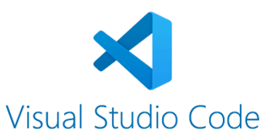

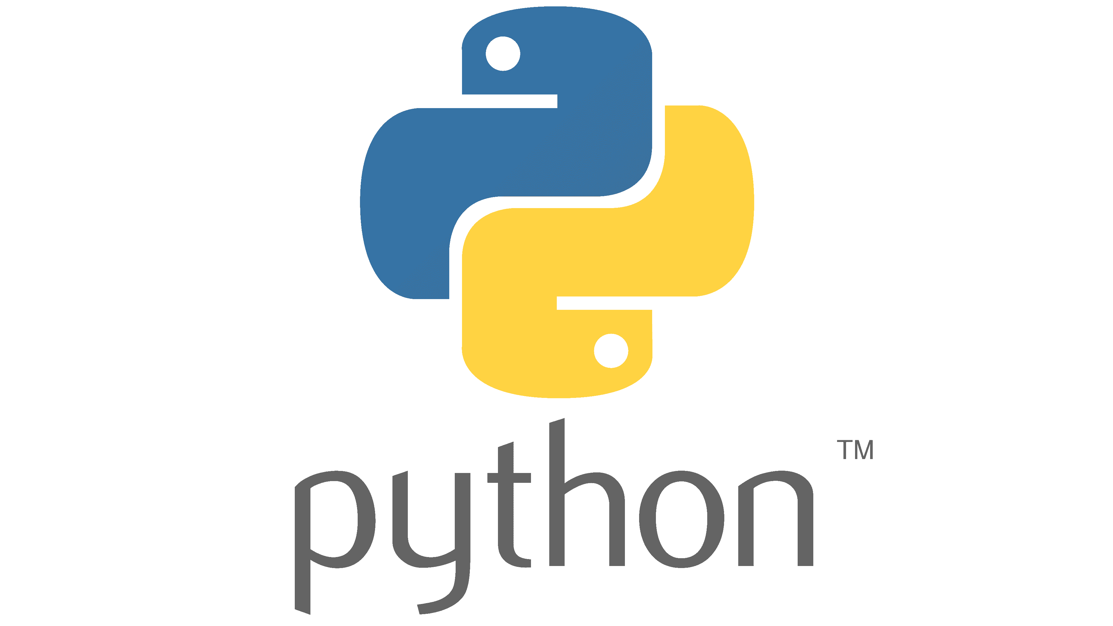
Workshop
LM Studio Can be done separately
VSCode code completion Can be done separately
Python local RAG using ollama Requires setup from VS Code workshop

Slide 20
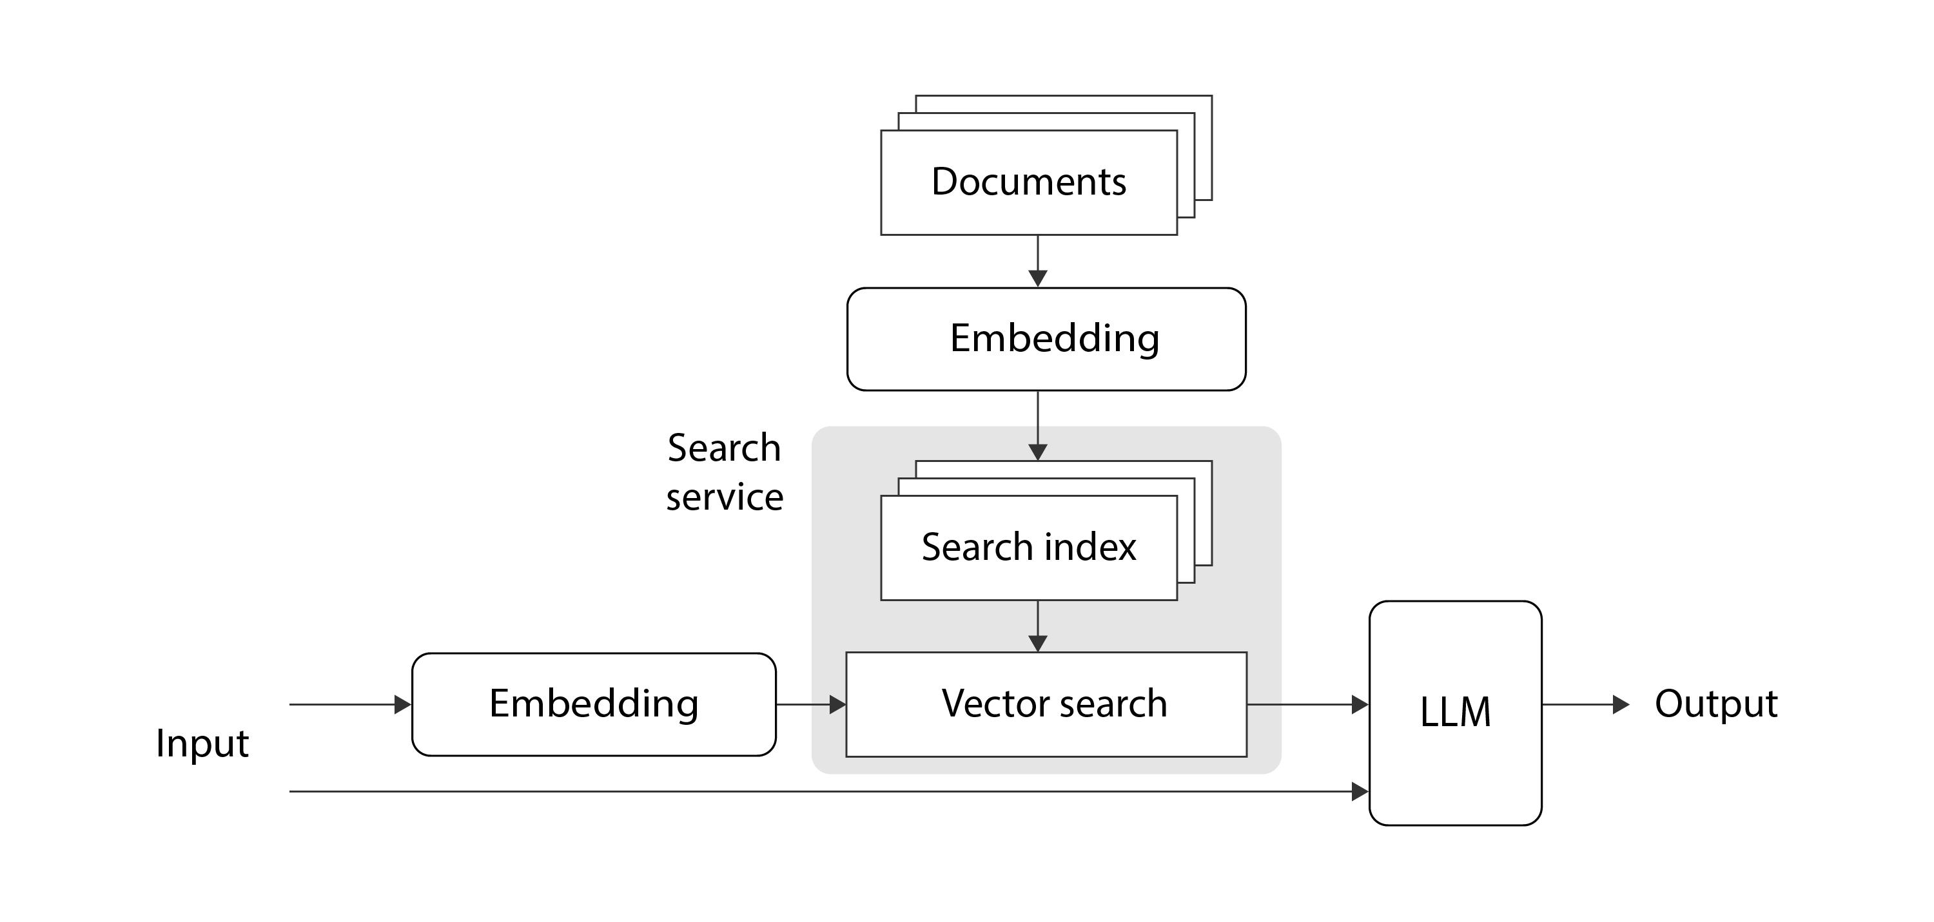

workshop python RAG: indexing
Local JSON documents
mxbai-embed-large-v1 (Huggingface transformers on CPU)
mxbai-embed-large-v1 (Huggingface transformers on CPU)
dolphin-mistral:7b
(ollama by API)

Slide 21
workshop
https://github.com/AMISConclusion/Workshop_LocalLLM

Slide 22
Logo
www.conclusion.nl

